Slide 1
CS 419: Production Rendering Geometric Modeling with Implicits
Eric Shaffer

Slide 2
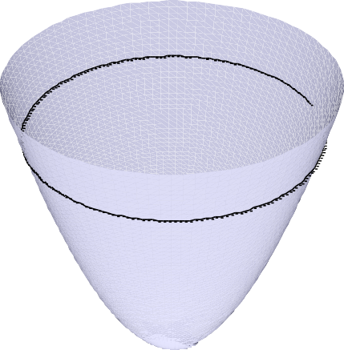
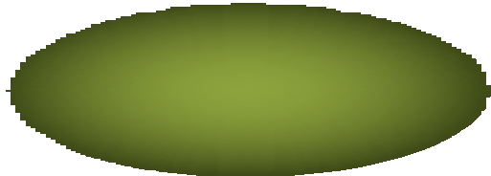


Implicit Surfaces
◉ Real function f (x,y,z)
◉ Classifies points in space
◉ CAGD: inside f < 0, outside f > 0
◉ Surface f⁻¹(0): Manifold if zero is a regular value of f
f=0
1
f < 0
f = 0
f > 0
(0,0)
f > 0 f < 0
Circle example
f(x,y) = x² + y² – 1
z = f(x,y)

Slide 3
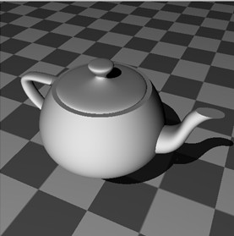
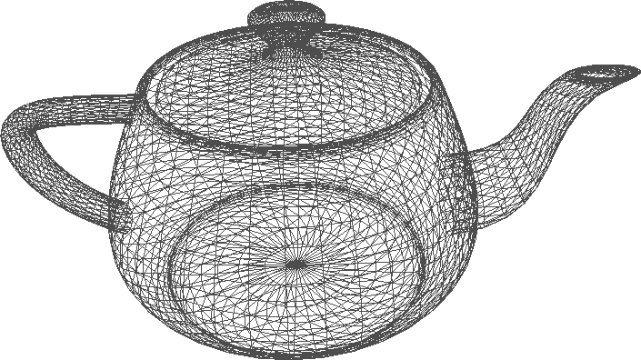
Why Use Implicits?
◉ versus polygons
◉ smoother
◉ compact, fewer higher-level primitives
◉ downside: harder to real-time render
◉ versus parametric patches
◉ easier to blend
◉ no topology problems
◉ lower degree
◉ easier to ray trace
◉ well defined interior  downside: harder to parameterize
◉ What’s an example of a parametric patch?

Slide 4

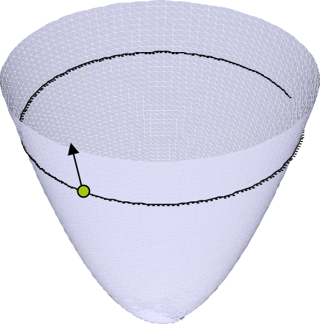
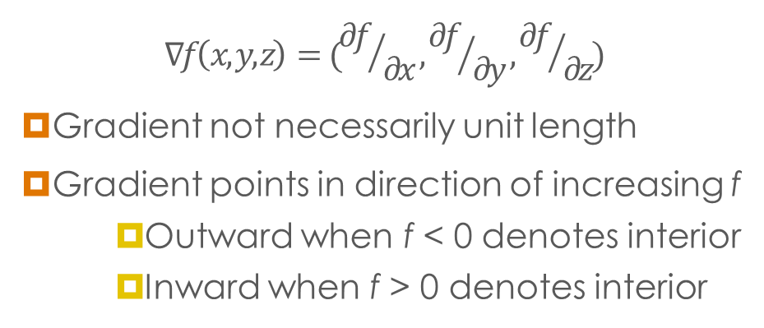
Surface Normals
1
f < 0
f > 0
f=0
(0,0)
◉ Surface normal usually gradient of function
$$∇f\left(x,y,z\right)=({∂f}/{∂x},{∂f}/{∂y},{∂f}/{∂z})$$
◉ Gradient not necessarily unit length
◉ Gradient points in direction of increasing f
◉ Outward when f < 0 denotes interior
◉ Inward when f > 0 denotes interior
Circle example f(x) = x² + y² – 1 x = (x,y)
◉ How do you perform ray intersections?
z = f(x,y)

Slide 5
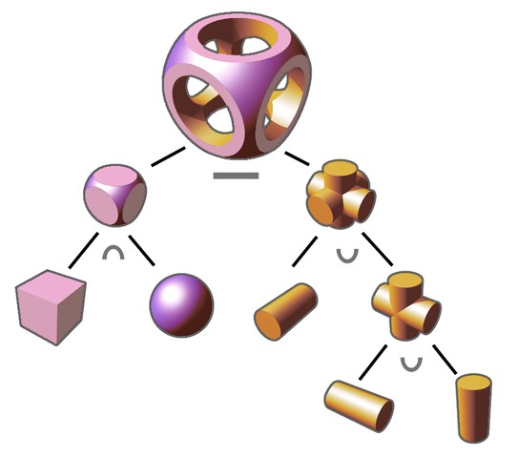
CSG:
Constructive Solid
Geometry
◉ Assume f < 0 inside
◉ CSG ops by min/max ops
◉ Union: min f,g
◉ Intersection: max f,g
◉ Complement: -f
◉ Subtraction: max f,-g
◉ Problem: C¹ discontinuity
◉ Can we smooth the blend crease?
◉ Anyone remember the technique?
f < 0
g < 0
f < 0
g < 0

Slide 6
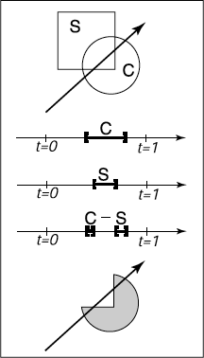
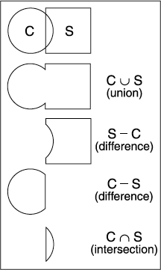
Ray Tracing CSG Objects
◉ Intersect the ray with each basic object
◉ Where are these object located in the tree?
◉ Each intersection generates an interval on the ray
◉ Perform the boolean operations on the ray
◉ Pro-tip: Work in parametric space, not world coordinates

Slide 7
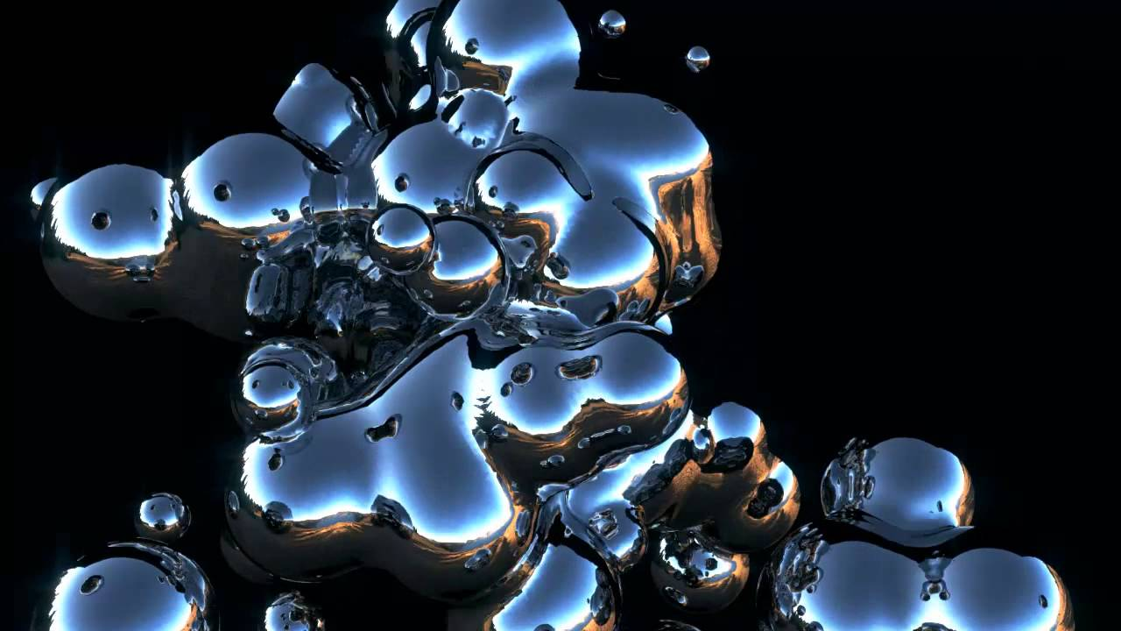
Uses of Blobby Modelling
Organic forms and nonlinear shapes
Scientific modelling (electron orbitals, some medical imaging)
Muscles and joints with skin
Rapid prototyping
CAD/CAM solid geometry

Slide 8
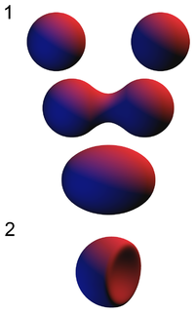
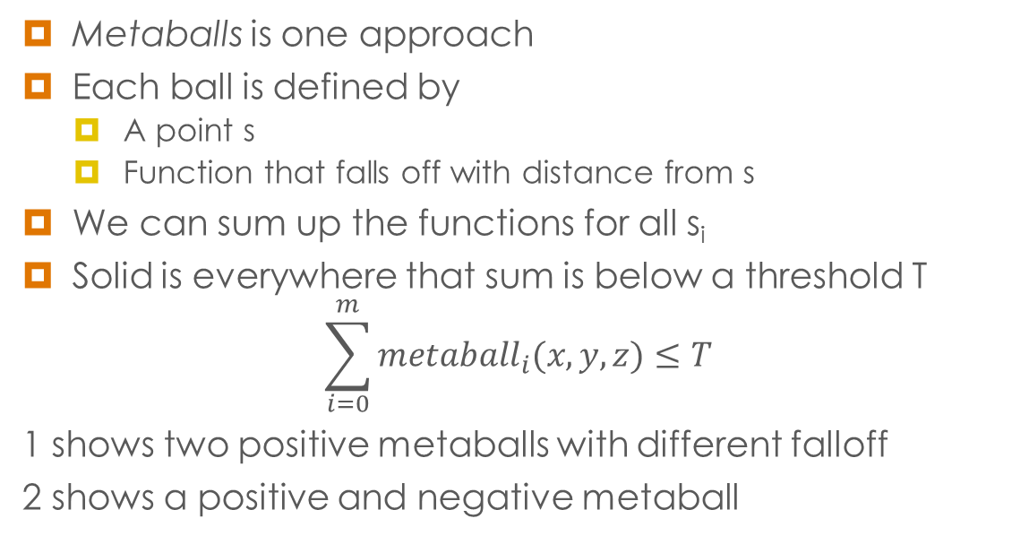
Blending Implicits
Metaballs is one approach
Each ball is defined by
A point s
Function that falls off with distance from s
We can sum up the functions for all s_{i}
Solid is everywhere that sum is below a threshold T
$$\sum_{i=0}^{m}{{metaball}_{i}(x,y,z)≤T}$$
1 shows two positive metaballs with different falloff
2 shows a positive and negative metaball

Slide 9
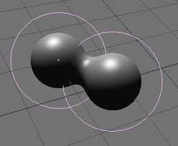

What is a Good Blobby Function?
Several force functions work well. Examples:
“Blobby Molecules” - Jim Blinn
$F\left(r\right)=a e^{−br^{2}}$
‘b’ is related to the standard deviation of the curve
‘a’ to the height.

Slide 10
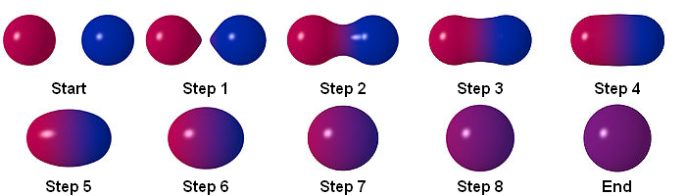
Metaball Functions
Several force functions work well. Examples:
“Metaballs” - Blinn again (I think)
F(r) = { a(1- 3r² / b²) 0 <= r < b/3 { (3a/2)(1-r/b)² b/3 <= r < b { 0 b <= r
Here ‘a’ is a scaling factor and ‘b’ bounds the radius of effect.

